Slide 1
ORDINANCE 23-03 FUEL MITIGATION workshop
By Kimberly Giuliacci
Fire Marshal, Woodside Fire Protection District

Slide 2
ANNOUNCEMENTS
Public Education and Emergency Preparedness Division
“When Disaster Strikes, Prepare, Act, Survive” taught by TEEX, out of Texas Jan 19-20, no fee, at Station 19.
Family First Aid kits available on WPV-Ready store, link on website.
Chipper Schedule, when released, we will ask you to please go to website to confirm your date.
First reading of Fuel Mitigation Ordinance has been scheduled to Feb 27th.

Slide 4
Inspection process
requesting an inspection
Timeline
Call Fire Admin 650-851-1594
Email: info@woodsidefire.org
Demonstrate progress
Reinspections – generally in 3-6 months.
What’s included $0
compliance
Walk with Inspector for a detailed inspection.
Receive a report via email.
Upload your photos to Fireaside (our preference)
Call for reinspection
Will be notated at time of reinspection.
code compliance
Fire Code
Residential Code
Local Ordinances (Fuel Mitigation, Nuisance, Fire Code)

Slide 5
Defensible space / home hardening
scope
Photos
This will be a guide for the property owner on the Fuel Mitigation Ordinance 23-03
Examples of before and after
Defensible Space Diagram for different size lots
Additional info
Separation requirements
Resources and details on groundcover (including height)
Guidance will be provided, taking into account the differences in fire behavior pertaining to different species of trees.

Slide 6
Common questions
DSI and your neighbor
Term Clearance
It is up to owner to invite their neighbors or to coordinate with neighbors for joint inspections.
To provide the maintenance requirements as outlined in this ordinance. It does not mean to remove everything in sight.
Homes over 15 years
Residents who have lived in the same home +50 yrs
Regardless if one day selling, ordinance requirements apply.
“Start by doing what is necessary; then do what’s possible; and suddenly you are doing the impossible.”
Youngmen’s League: email Selena Brown sbrown@woodsidefire.org
List of vegetation
We are adding a page on our website for fire smart plants. Here you will find links to resources.

Slide 7
Common questions
Habitats / native species
Tree removals
Nothing in the ordinance requires removal of active habitats, nor native species.
A decision for removal will take time and research as well as guidance from professionals such as arborists.
Suggestions & Education for Zone Zero
New COnstruction
Adding “bare ground” to the list of hardscaping.
Acacia,Bamboo, Cypress, Eucalyptus, Junipers and Monterey Pines which are highly flammable. New language under Education and Recommendation for existing construction: removal of these species.
Home hardening
Not in this ordinance, but will be enforced as set forth in the Government code. Homes built after 2008.

Slide 8
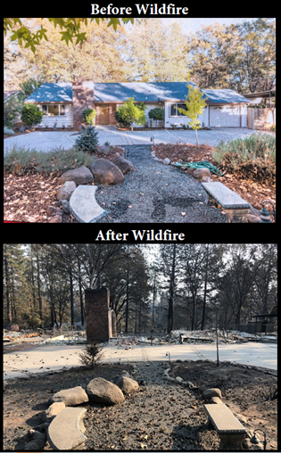
Fire demonstration shows survivability of structures with at least 5 feet of absolute clearance - ABC7 Los Angeles

Slide 9
RESPONSES
Resale of home
Ember Resistant vents
AB38 only applies to homes in the high and very high.
Please refer to our website for information on ember-resistant vents, information can be found under Home Hardening. Redirects you to CalFire’s website “Hardening your Home”
Wooden steps in pv ranch
Homes/decks built around trees
Wooden steps are not required and some residents have already changed them to either metal, trex, or stone.
If your home is built around a redwood tree, we can recommend to make sure your house is well hardened, and that you maintain your tree, keeping branches at least 10 feet away from your roof and remove all dead, dry leaves from your roof.
Euks 20-30’ apart & limbed up
Yes, it’s ok. If dead or dying will require removal.

Slide 10
RESPONSES
Sample assessment
Privacy hedges
We are a work in progress. We are the sample. Drive around one of the 4 firewise communities we have here within our district. Or let’s see how we are looking in 3 years.
As long as they are outside of the 5 foot zone. And provide some spacing depending on the slope of your home.
Fire access road / driveway
Roadside vegetation
Both defined in the ordinance
10 feet from edge of road
5 feet from edge of driveway
13.5 feet vertically
No Parcel owner may allow any portion of vegetation on his or her property to interfere with street and emergency vehicle access, regardless of whether the access is along a public street or along a private residential access road.
Diff zone 1 & 2
No exposed wood piles
Zone 2 = an entire parcel
Zone 2 is from 30-100 ft of a structure.
(c) Adjacent Parcels. (1) When a Structure is less than 100 feet from a property line and Combustible

Slide 11
responses
Clearing property & effects on wildlife
Concern on habitat living on conrete
The ordinance addresses this:
(g) Environmental Concerns.
Nothing in the ordinance talks about concrete. Zone 0, which is o-5ft of the structure, suggests to use hardscape
groundcover
Section 3 Applicability
Definition will be added into the ordinance.
Means we take into consideration the construction of the structure in order to understand how everything surrounding it will affect it should the structure ignite.
Species not permitted in new construction
We are adding language: For new construction and existing structures….Exception: Those planted prior to adoption date.

Slide 12
responses
(e) Fences.
fence must be 6 ft from any structure - why 6 feet instead of 5 feet?
..any screen, fence or other Structure made, in whole or in part, of bark, mulch, or wood chips … This means no man made mounds or mountains using the material to create a wall of privacy like a fence.
Studies have shown the success of 6 feet due to flame lengths, 12 inches makes a difference, hence the recommended distance of 6 feet
Process for abatement & citation
Appendix B - Continuous Tree Canopy Requirements
See Website for details on the ordinances.
Guideline will also include clear instruction
Yes, it is within 100 feet of a structure.
Section 7 - Phased Compliance
This applies to all properties regardless of parcel size.
New Definition will be added :Fire-resistive vegetation
Clarifying and providing distinction between brush and fire-resistive vegetation.

Slide 13
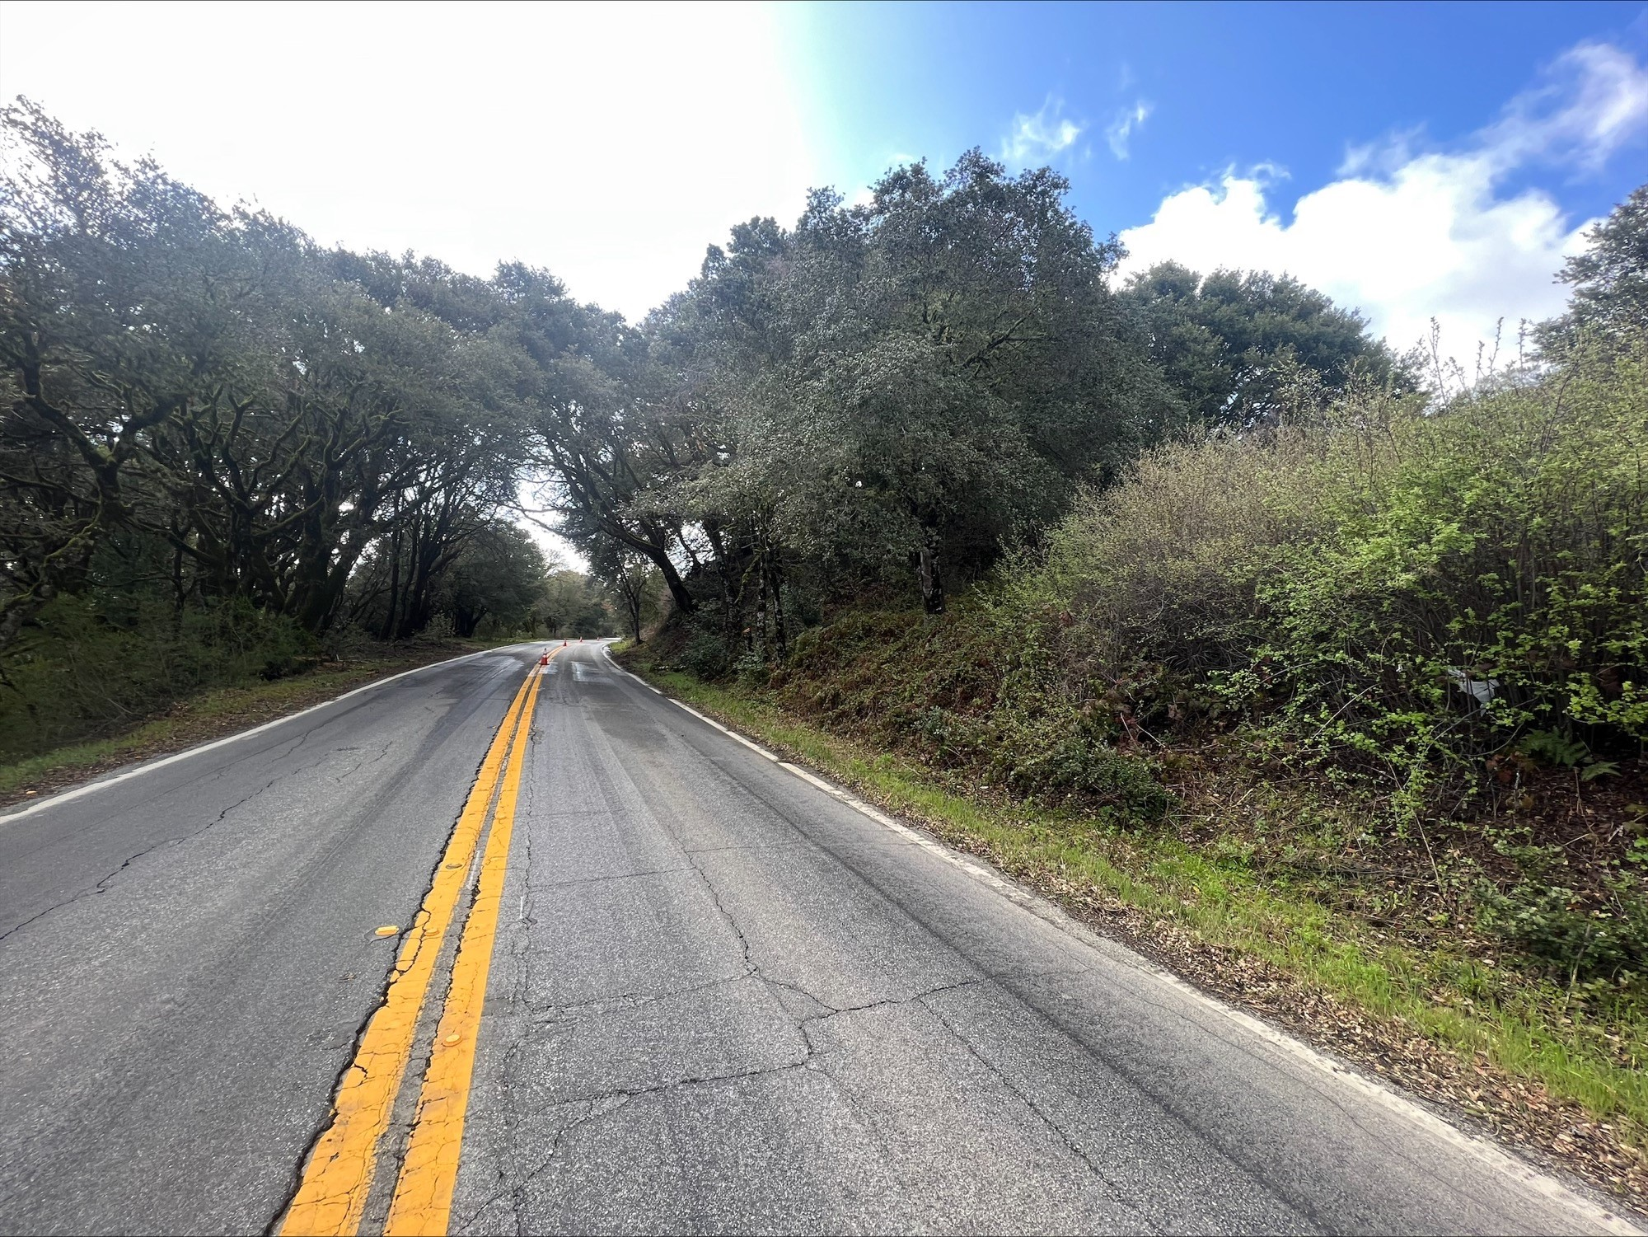
summary
Careful research is required to find the most fire safe and most native trees in your area. You can plant trees that create a natural firebreak and give you the best chance of stopping a fire’s progress. With careful considered planting, you can create a landscape that is more resistant to wildfires.

Slide 14
Thank you
Kimberly Giuliacci
650-530-2840
kgiuliacci@woodsidefire.org
www.woodsidefire.org

